Slide 1
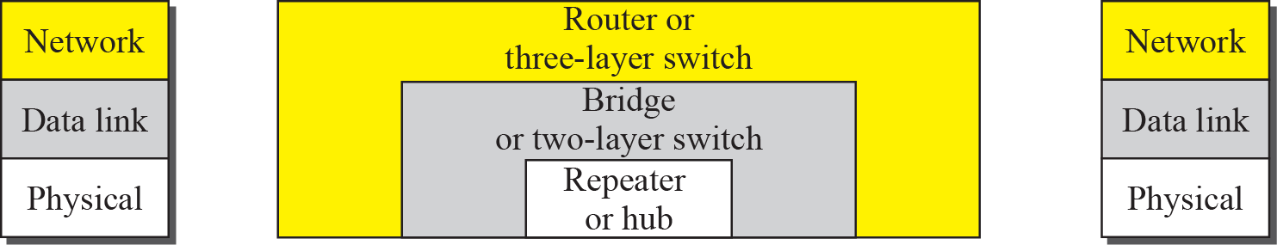
Connecting devices

Slide 2
Internetworking Essentials CSE307
Lab 1

Slide 3
Poll 1
Router is also Known as
Three Layer Switch
Two Layer Switch

Slide 4
Hub
A hub forwards every bit; it has no filtering capability.

Slide 5
A router is a three-layer (physical, data link, and network) device.

Slide 6
A router connects independent LANs or WANs to create an internetwork (internet).

Slide 7
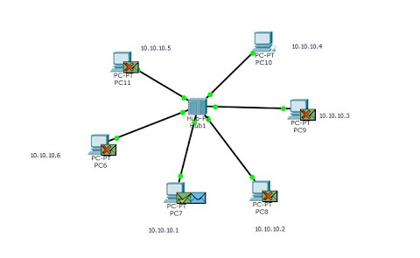
Hub example

Slide 8
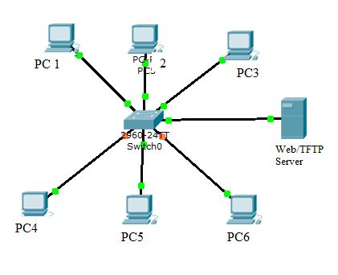
Switch example

Slide 9
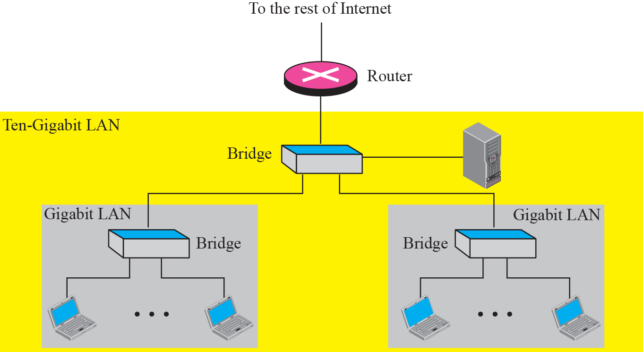
Routing example

Slide 10
Hub
Broadcast
More collision
Connect same networking device

Slide 11
Poll 2
Hub works at which layer
Data link layer
Physical layer
Network layer
Transport layer

Slide 12
Switch
Switch is intelligent device
Learning the address
Forwarding
Work on mac address

Slide 13
Poll 3
switch is also Known as
Three Layer Switch
Two Layer Switch
One layer Switch

Slide 14
Router
Connect different networks
Routing

Slide 15
Poll 4
Router is used to connect different type of networks
True
False

Slide 16
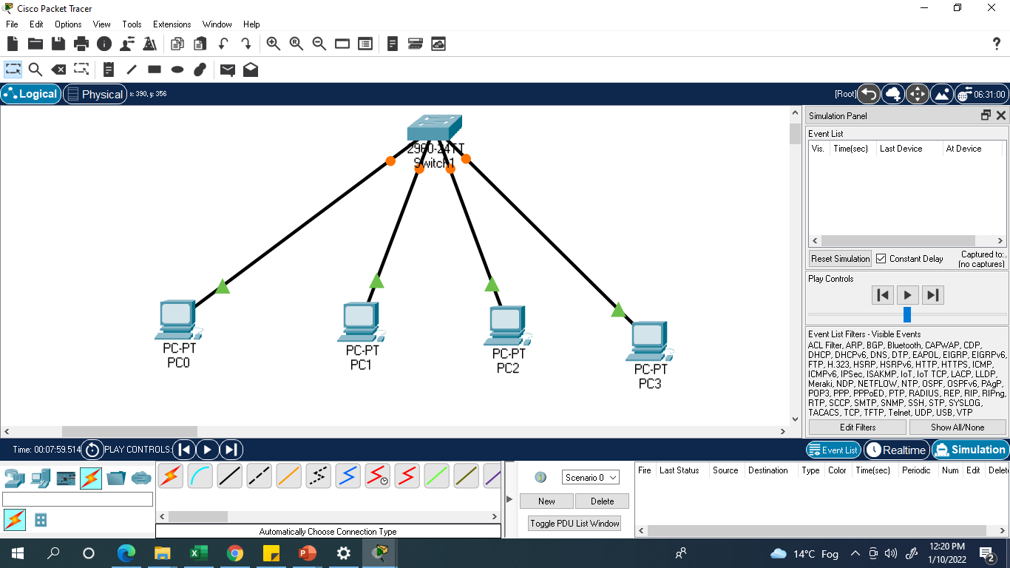


Slide 17
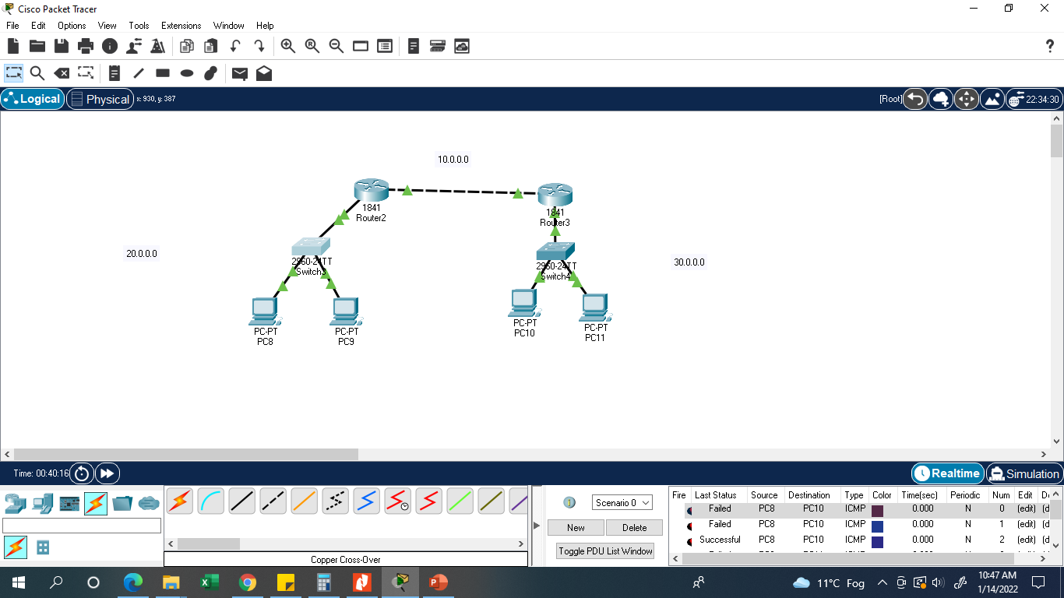

Slide 18
PC Command promopt
Packet Tracer PC Command Line 1.0
C:\>arp -a
No ARP Entries Found
ARP(Address resolution protocol)
C:\>arp -a
Internet Address Physical Address Type
10.0.0.4 0007.ec28.a5e9 dynamic

Slide 19
Switch CLI
command-line interface (CLI)
Switch>en
Switch#show mac-add
Mac Address Table
-------------------------------------------
Vlan Mac Address Type Ports
---- ----------- -------- -----

Slide 20
--- System Configuration Dialog ---
Would you like to enter the initial configuration dialog? [yes/no]: no
Press RETURN to get started!
Router>en
Router#?
Exec commands:
<1-99> Session number to resume
auto Exec level Automation
clear Reset functions
clock Manage the system clock
configure Enter configuration mode
--More--
Router#config t
Enter configuration commands, one per line. End with CNTL/Z.
Router(config)#
Router(config)#hostname CSE307
CSE307(config)#
CSE307(config)#exit

Slide 21
CSE307>show ip interface brief
Interface IP-Address OK? Method Status Protocol
GigabitEthernet0/0/0 unassigned YES unset administratively down down
GigabitEthernet0/0/1 unassigned YES unset administratively down down
GigabitEthernet0/0/2 unassigned YES unset administratively down down
Vlan1 unassigned YES unset administratively down down

